Slide 1
Engage and grow your community
Tips and tricks for a healthy community
Feedback from 20 years of community practice

Slide 2
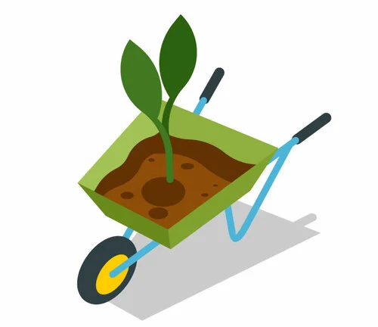
Context
There are many different types of communities concerned by this presentation.
There are online communities, localized communities, shared interest communities.
They all require similar care and handling.

Slide 3
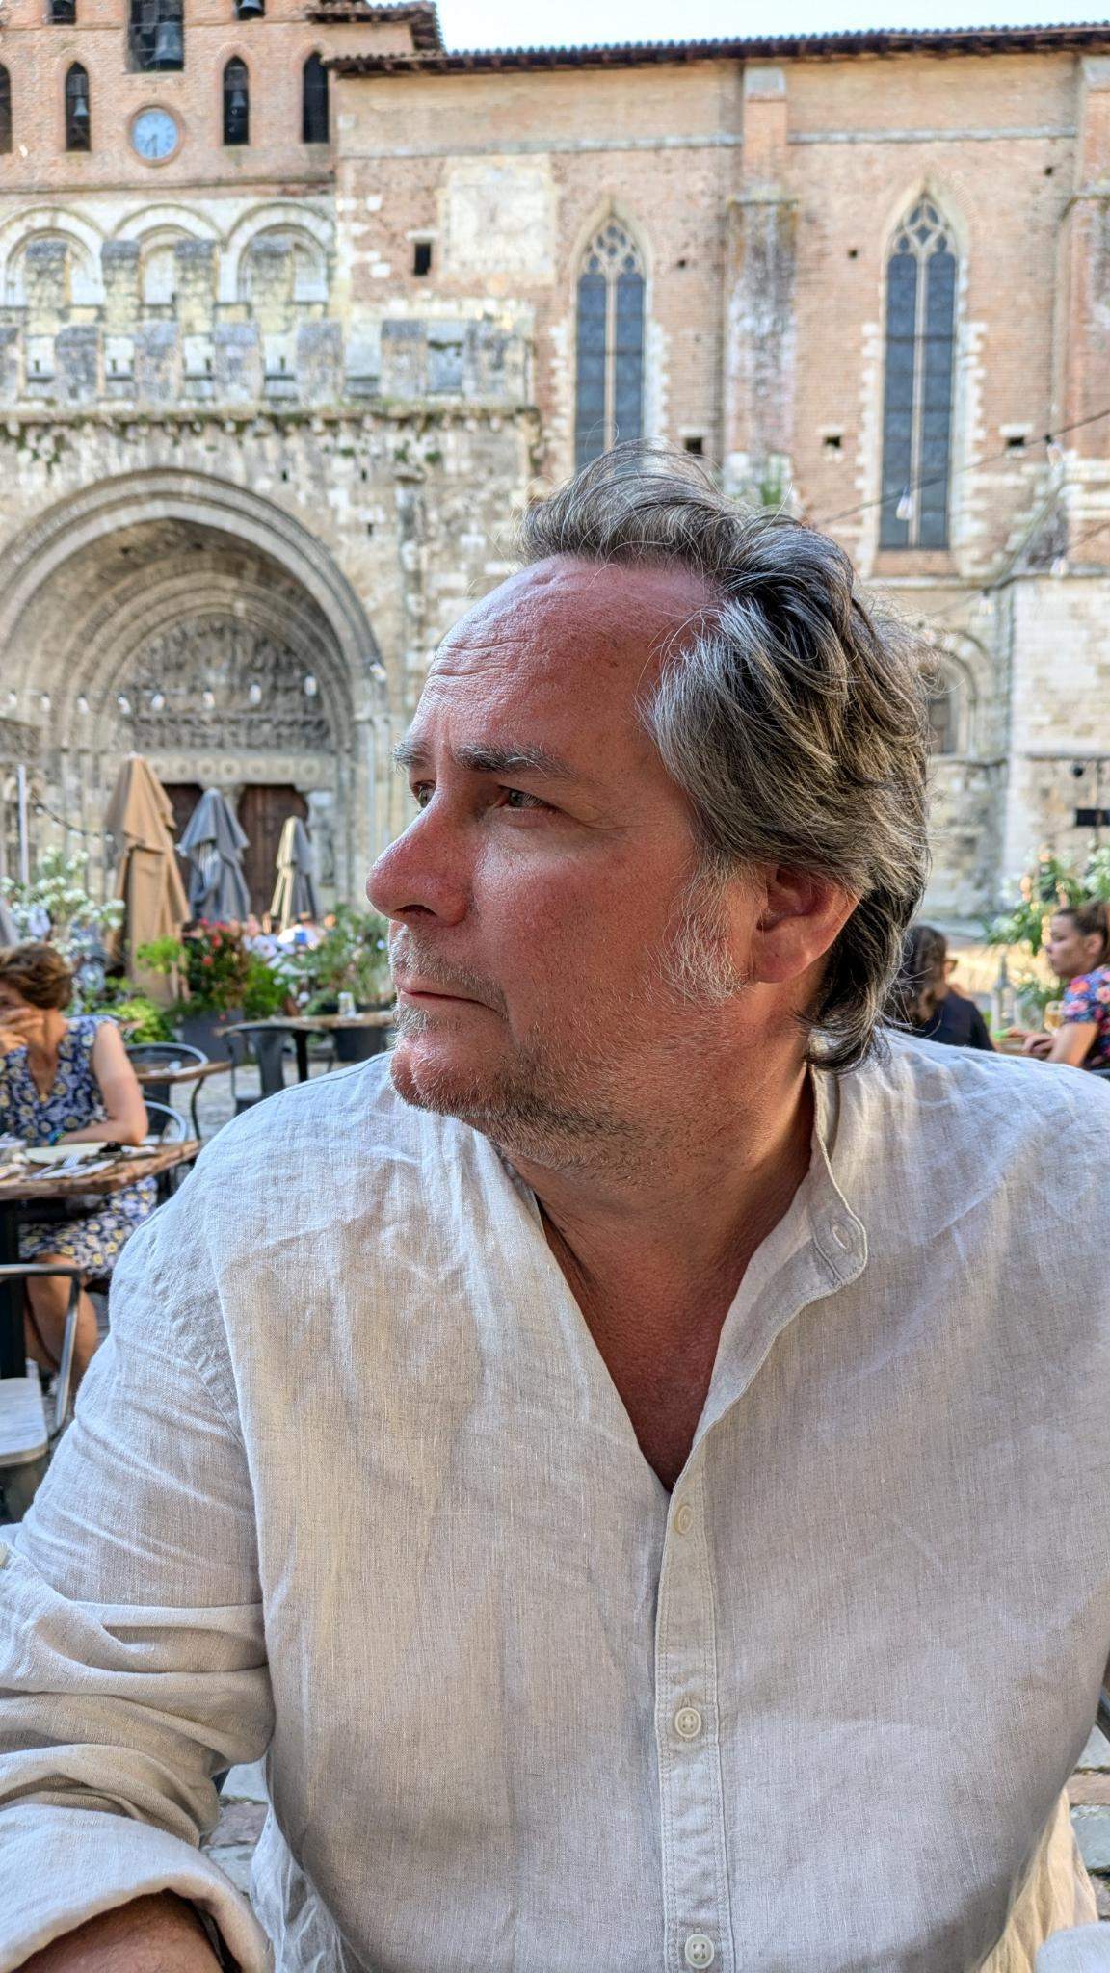
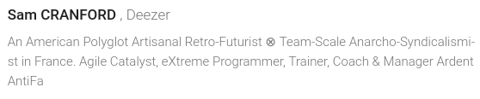


Who am I?
An old Agilist
eXtreme programmer
Technical and agile trainer
A noter: présentation en fr_US
@nostradamnit@mamot.fr
/in/samcranford/

Slide 4
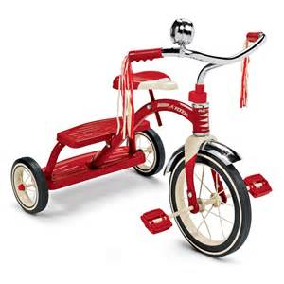
ATTN : version 0.1
This presentation is still in development.
This presentation will be participative and interactive

Slide 5




Why me?
I have been an active member, of various levels of engagement, in several communities for the last 20+ years.
The communities have participated in:
support forums, like StackOverflow
User Groups, like aGeNUx and Girolls
developer and/or agile communities like Okiwi
Software focused communities like DjangoFr
Social communities, like BBC, BLIB or Jazz&Garonne
Formal communities, like Parent/Teacher association
Okiwi
Catalyseur d'évènements informatiques

Slide 6
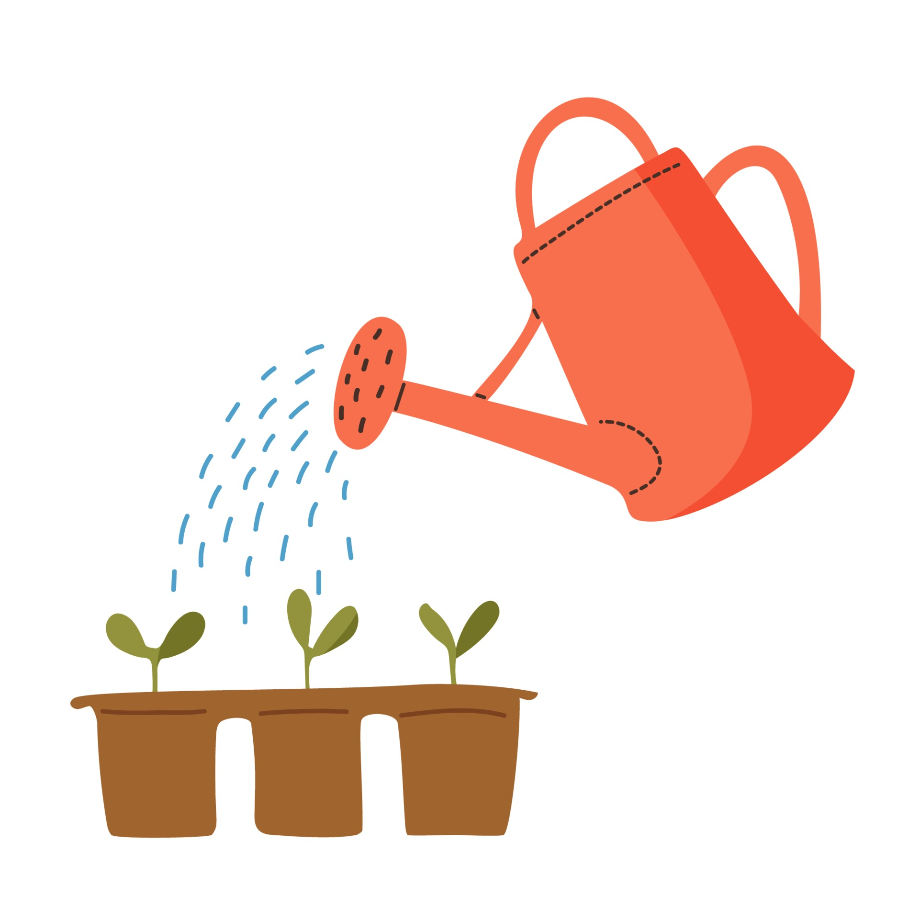
Engage your community
Despite the different types of communities, there are lots of commonalities and similar ways of engaging the members.
Fortunately, a lot can be learned from work and social situations. Successful team building and work structures can be insightful.
A big difference in community building is the
lack of hierarchical structure and work obligations.

Slide 7
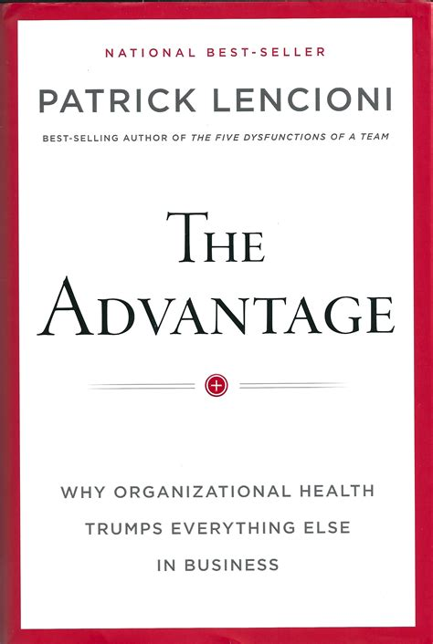
Goals and values
The goals and values of the community are important motivators. Depending on the founding ideas behind the community, these might be evident, or might need some exploration.
Once the goal and values are clear (enough), the community can start growing and engaging its members.
Patrick Lencioni has some excellent advice on formulating values.
Notes:
Core values
These are deeply ingrained principles that guide all of the company's actions and are part of the organization's culture.
Aspirational values
Values lacking, but needed.
Permission-to-play values
Values that reflect minimum behavior and social standards for employees.
Accidental values
Values that develop without being cultivated by management and reflect the common interest and personalities of employees.

Slide 8
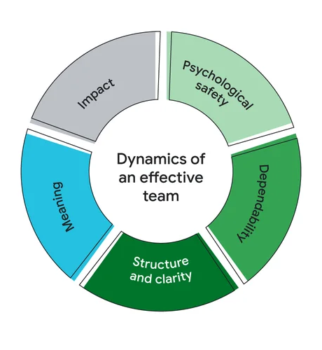
Safe place
In general, in order to successfully engage and grow the community, it needs to be a safe place to share the common passion. While physical safety is essential, psychological safety is equally important.
The members need to feel free to share their thoughts and feelings, without unpleasant consequences.
I particularly like the The five dynamics of effective teams, notably Psychological safety.
https://www.thinkwithgoogle.com/intl/en-emea/future-of-marketing/management-and-culture/five-dynamics-effective-team/

Slide 9
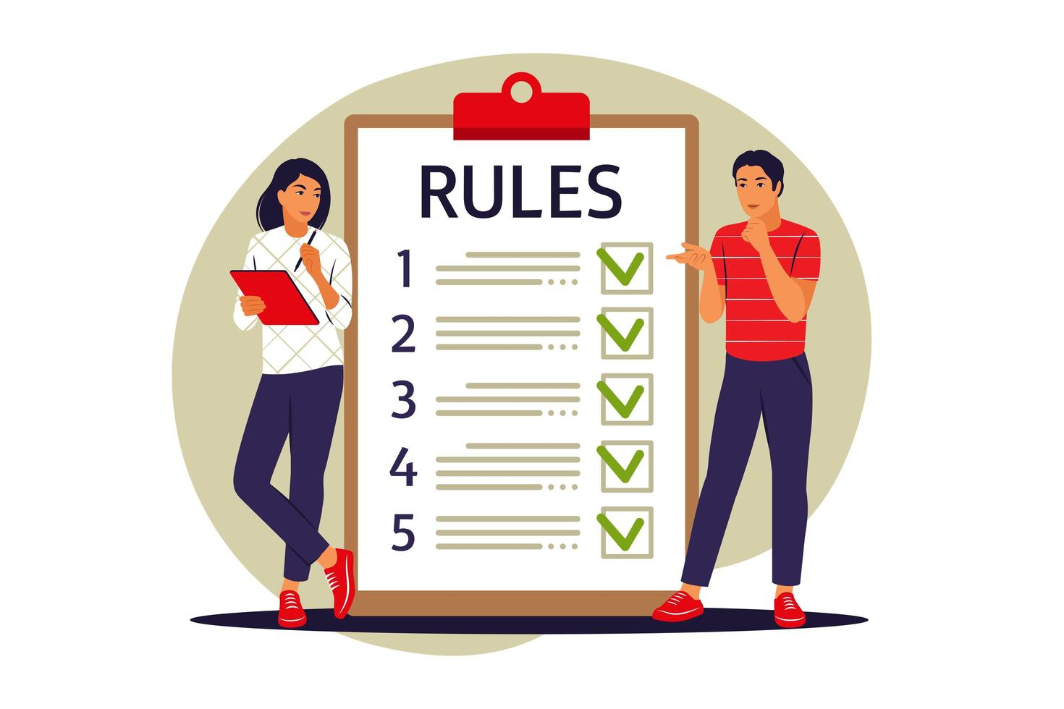
Rules and regulations
No one ever likes to talk about them, but you’ll be glad you did.
Setting clear guidelines, for various aspects of the community, will help avoid issues before they arise. Depending on the goals of the community, they could be coding rules, commit rules, documentation rules, interaction rules, virtually any common practices that could become conflictual deserves at least a discussion around rules.
I especially like the Recurse Center’s rules

Slide 10

Statues
Depending on the type of community, you might have to have some legal statues.
In France, if you are an Association 1901, then there are regulations around the associations statues. In this case, the statues are legally binding, and in case of litigation, they will be used as the basis of the judgement.
It’s worth spending some time formulating and revising them,
possibly with qualified legal counsel.

Slide 11

Code of Conduct
A rather specific type of rules, which specifies how to interact respectfully.
It is very common for events that unite many people together, like conferences, to have a published Code of Conduct. Most often, these rules seek to ensure peaceful, respectful co-existance and non-discrimination. They specify sanctions for non-adherence, mainly being asked to leave.
Having a clear code of conduct helps greatly in
guaranteeing a safe place to interact.

Slide 12
Internal regulations
Another rather specific type of rules, which can include how to resolve conflicts.
These are usually reserved for very big organizations or business. They outline guidelines for handling recurring situations, such as negotiations, contracting and corrective actions.

Slide 13

Legal compliance
Depending on the location and activities, there are probably some legal obligations.
A common legal aspect is licensing, which license to use, etc.
Another is in-person safety and regulations, insurance and liability.
Anti-discrimination legislation falls into this category as well.

Slide 14
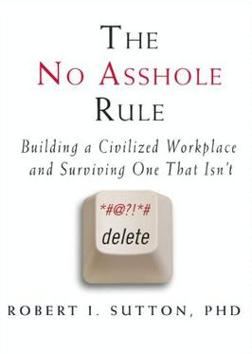
Expect good behavior
Everyone should always be on their best behavior.
Everyone has bad days and makes mistakes.
Rules and regulations are there to help people be their best.
And to identify unacceptable behavior and how to deal with it.
Trolls and assholes can not be tolerated

Slide 15




Discussions
You’ll probably need some kind of platform to facilitate discussion. It’s best to think and discuss before choosing.
Try to avoid having multiple channels when possible.
Once you decide and start using one, moving to another is very difficult.
irc
worse
better

Slide 16
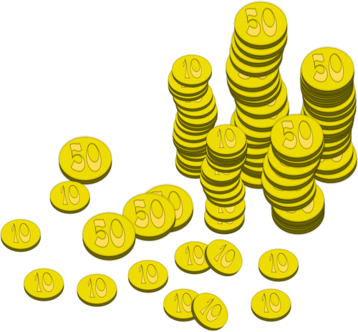
Finance
At some point, you’ll have expenses and maybe even have some funds. Depending on the structure of the community, these might also be subject to legislation and control.
It would be a good idea to have some form of financial governance,
be it a treasury or group who maintains the financial records.

Slide 17

Activities
This is probably the real reason the community exists, the uniting activities that motivates all of the members. There can be several different ones.
For Open Source projects, it is most likely that you will be distributed across the world and therefore in remote activities.
Local groups should try to meet up physically regularly.

Slide 18

Physical activities
When it’s possible to reunite some or all of the member together, it is an excellent way to build ties and friendship within the community.
Some common activities are:
Ensemble coding sessions and coding dojos
Open Space conferences
Lunches and dinners
Happy Hours
  (but be sure to welcome non-drinkers and minors)

Slide 19

Online activities
As we’ve all learned since 2020, we can replicate fairly well many physical activities in remote, via videoconferencing and shared spaces.
Access to an online whiteboard solution, or hosting your own, will facilitate many activities.

Slide 20

Asynchronous activities
Some activities lend themselves well to asynchronous participation.
Meetings to brainstorm or decide on group projects can often be done asynchronously with shared documents, such as HackMD or CryptoPad.
Just plan the activity, share the board, add some time constraints and set a review meeting to discuss the results.

Slide 21
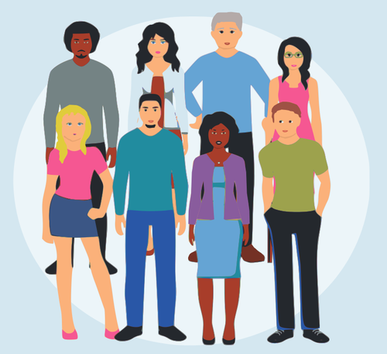
Recruitment
How will you get people to join your community?
What is the process for joining?
What defines a member? Are there multiple levels of membership?
These are all questions to be worked out by the club.

Slide 22
Contributing
A very common way of recruiting new member in Open Source projects is the famous contributing(.md)
Contributing is a document at the root of the repository that explains how to join the project. It should be a short guide to how someone can help the project.
It is an important part of any Open Source project, often seen as the anchor.
There is also a web site (https://contributing.md/) that has lots of information on building and growing Open Source projects

Slide 23
Web presence
The community will almost certainly need a web presence of some sort, especially for recruiting contributors and users.
Most git-based projects support hosting static html sites simply.
There are many non Open Source options available, from LinkedIn to Facebook. Depending on your values and goals, one of these might be a viable option.
Acquiring a domain name for the community will facilitate communication and recruitement.
Note: having a web presence requires periodic updates, or it can become a detriment.

Slide 24

What did I leave out?
As I sure many of you are as experienced as I am, what aspects did I not include? What would you like to see in this presentation?
And thanks for your ideas and contributions!

Slide 25
Thanks!
Thanks for coming and for your feedback!

Slide 26

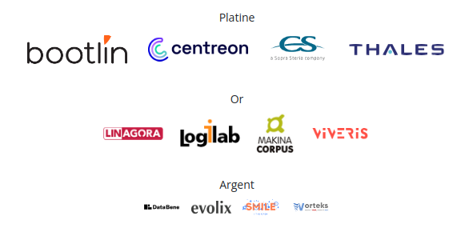
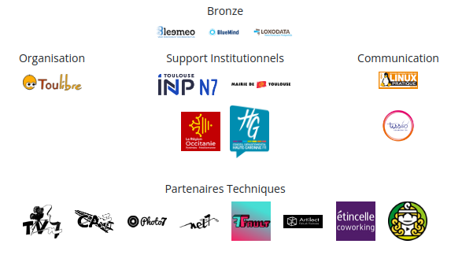
Thanks to the organizers, volunteers & sponsors

Slide 27
Legalese (lēˌgə-lēzˈ, -lēsˈ)
Cette présentation est sous les licences
Beerware
WTFPL
All images used without explicit permission, but with attribution.
Many came from https://publicdomainvectors.org/

